Slide 1
Staff Login
Username
ADD AN IMAGE
Password
Login
Create a new user
Forgot Password

Slide 2
Create an account
First Name
Last Name
ADD AN IMAGE
Contact No.
Email
Security Q
Security Ans
Password
Confirm Password
I agree to the Term & conditions
Sign Up

Slide 3
RESET PASSWORD
Email
ADD AN IMAGE
Security Question
Security Answer
New Password
Confirm Password
Submit

Slide 4
ADD LOGO
ADD AN IMAGE
FRONT DESK OPTIONS
CUSTOMER
BOOK ROOM
BLACK SPACE. While no option is clicked it will show a picture of the hotel.
ROOM DETAILS
ADMIN LOGIN
LOGOUT
ADD IMAGES

Slide 5
ADD LOGO
ADD AN IMAGE
View Details and Search System:
Search By:
FRONT DESK OPTIONS
Customer Details
Customer Ref:
First Name:
Last Name:
Gender:
Post Code:
Mobile:
Email:
Citizenship:
ID Proof Type:
ID Number
Address:
Ref or email
Input
Search
Show All
CUSTOMER
BOOK ROOM
The Entries go there
ROOM DETAILS
Customer Details Displayed
ADMIN LOGIN
LOGOUT
ADD IMAGES
ADD
UPDATE
DELETE
RESET

Slide 6
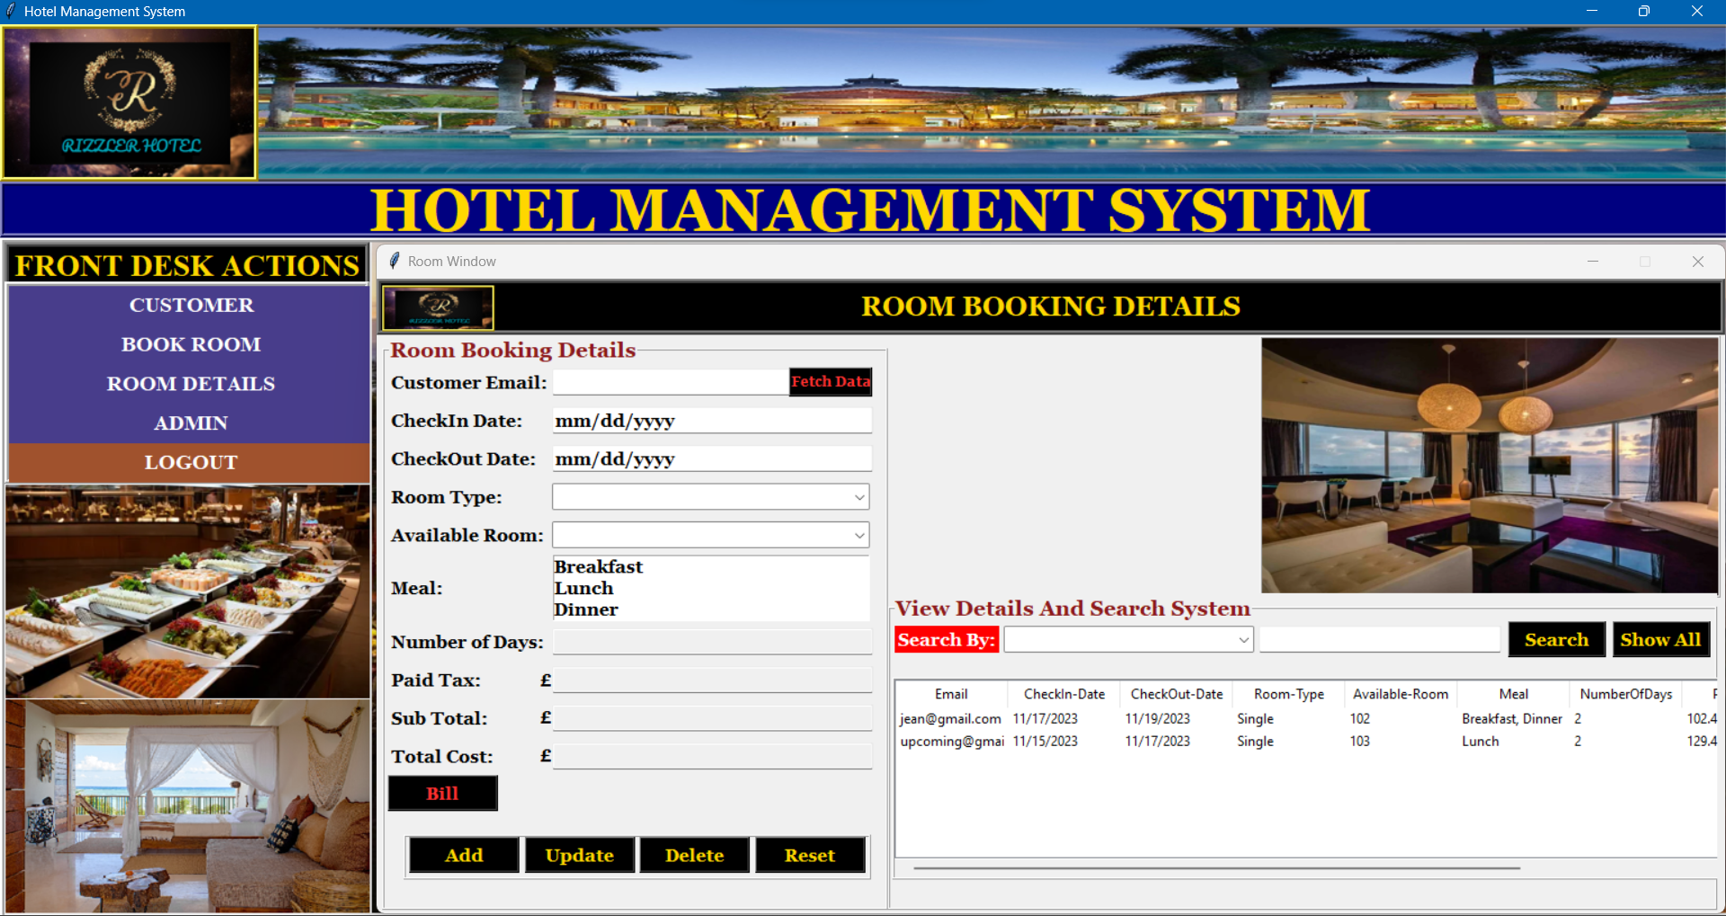
ADD LOGO
ADD AN IMAGE
FRONT DESK OPTIONS
Room Booking Details
Customer Email:
CheckIn Date:
CheckOut Date:
Room Type:
Available Room:
Meal:
Number Of Days:
Sub Total:
Total Cost:
Customer Details
First Name:
Last Name:
Gender:
Mobile No:
Citizenship
ADD AN IMAGE
CUSTOMER
Fetch Data
BOOK ROOM
ROOM DETAILS
View Details and Search System:
Search By:
ADMIN LOGIN
Ref or email
Input
Search
Show All
The Entries go there
LOGOUT
Room Booking Details Displayed
ADD IMAGES
BILL
ADD
UPDATE
DELETE
RESET

Slide 7
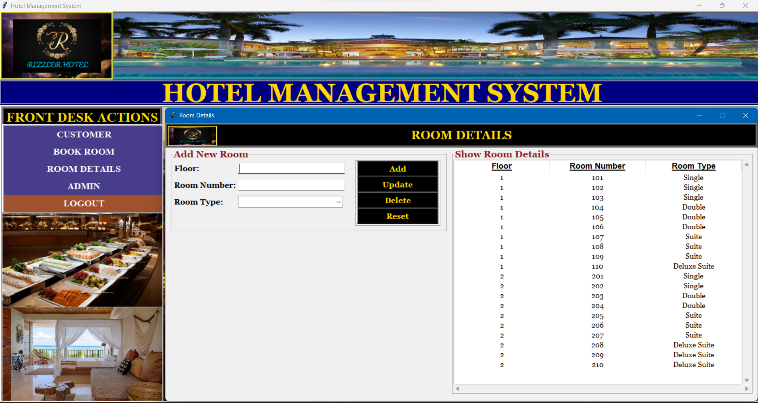
ADD LOGO
ADD AN IMAGE
FRONT DESK OPTIONS
Add New Room
Floor:
Room Number:
Room Type:
Show Room Details
CUSTOMER
BOOK ROOM
The Entries go there
ROOM DETAILS
Room Details Displayed
ADD
UPDATE
DELETE
ADMIN LOGIN
RESET
LOGOUT
ADD IMAGES

Slide 8
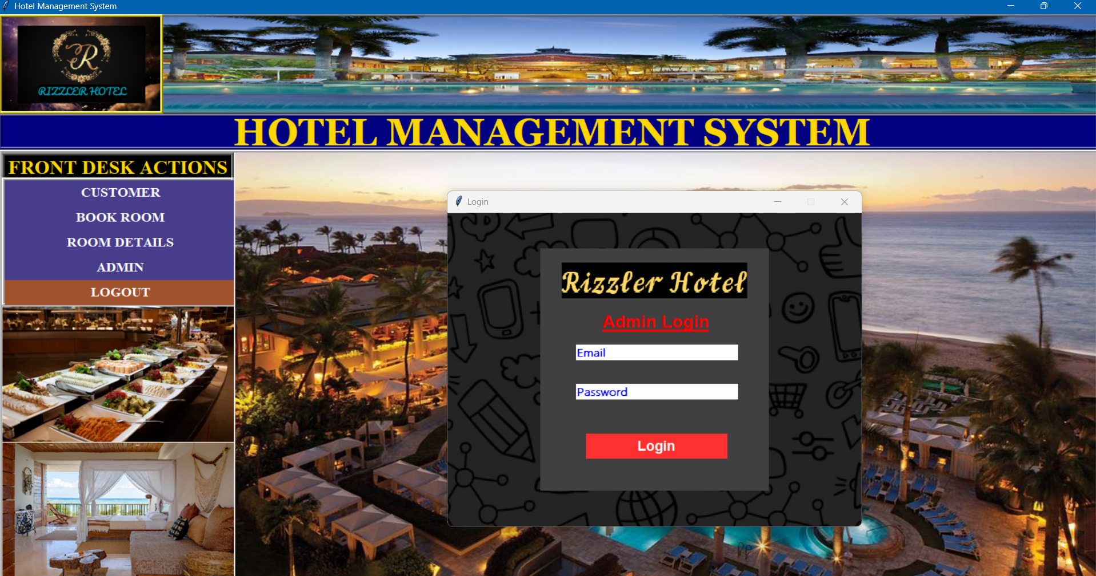
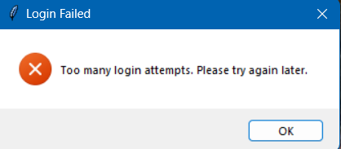
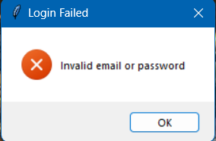
ADD LOGO
ADD AN IMAGE
FRONT DESK OPTIONS
CUSTOMER
Rizzler Hotel
BOOK ROOM
ROOM DETAILS
Admin Login
ADMIN LOGIN
Email
LOGOUT
Password
ADD IMAGES
Login

Slide 9
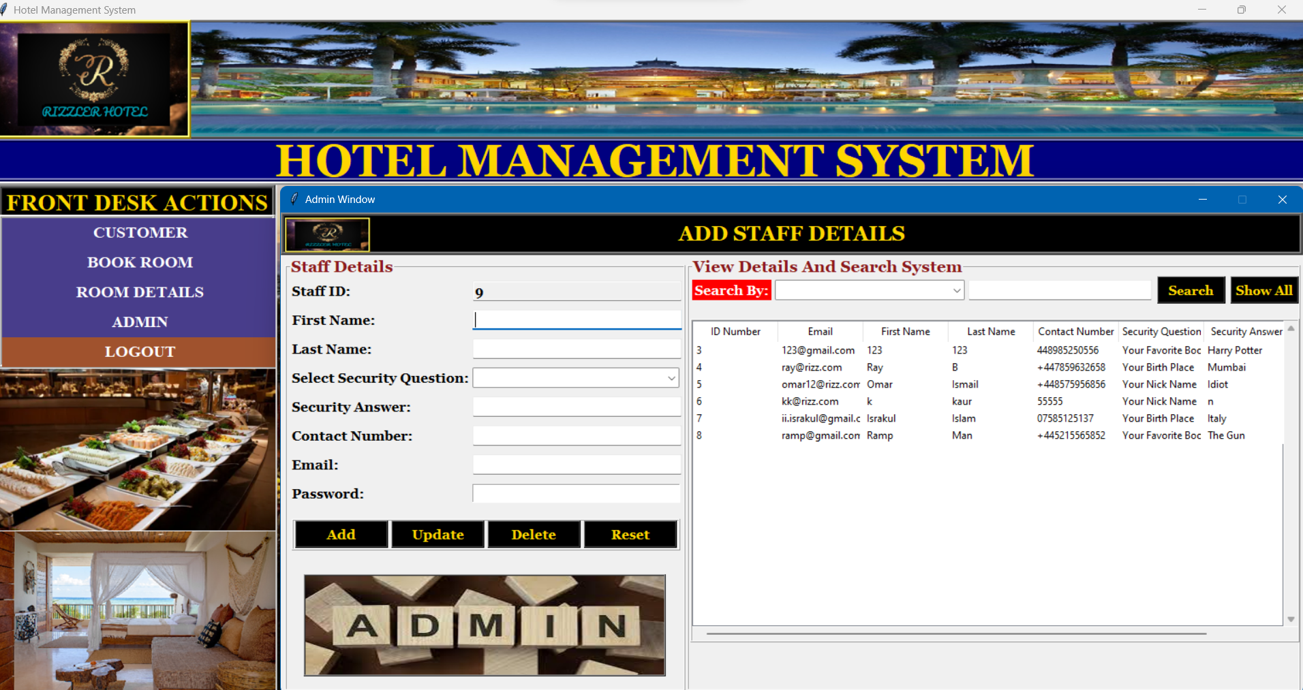
ADD LOGO
ADD AN IMAGE
View Details and Search System:
Search By:
FRONT DESK OPTIONS
Staff Details
Staff ID:
First Name:
Last Name:
Select Security Question:
Security Answer:
Contact Number:
Email:
Password:
ID or email
Input
Search
Show All
CUSTOMER
BOOK ROOM
The Entries go there
ROOM DETAILS
Staff Details Displayed
ADMIN LOGIN
LOGOUT
ADD IMAGES
ADD
UPDATE
DELETE
RESET
ADD AN IMAGE

Slide 10
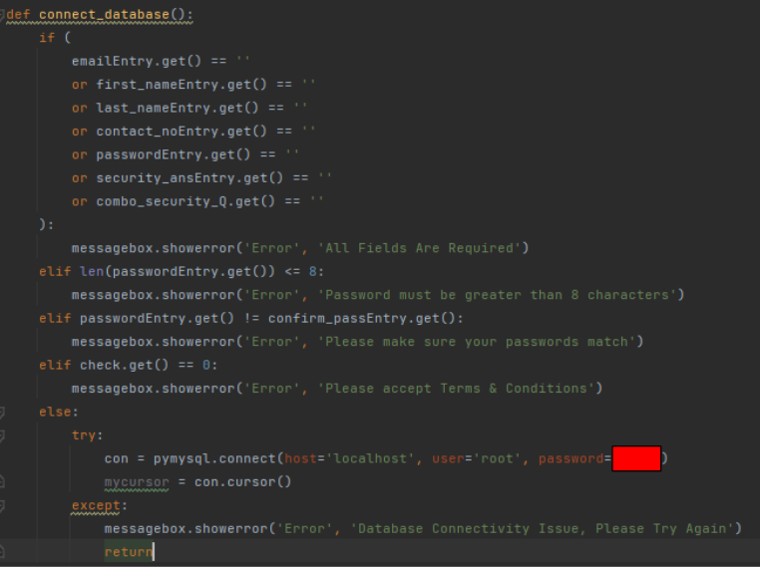
﻿If there is a connectivity issue, an error message box is displayed
The variable ‘mycursor’ is the cursor

